Slide 1



SNAKE GAME
PROJECT MEMBERS : BHARATHI T (23ITR015)
CHIBA ROSHAN A (23ITR019)
ELAKYA R (23ITR045)
JAIHARI D (19ITR028)

Slide 2
ABSTRACT
The Enhanced Snake Game modernizes the classic game by adding user authentication and high score tracking to boost replayability and personalization. Built with Python and Pygame, it maintains the original mechanics while integrating secure login and unique player profiles, with high scores stored in a local database to drive engagement. Players navigate a growing snake, avoiding collisions, while Pygame ensures a smooth, interactive experience. The project demonstrates key programming concepts such as real-time graphics, database management, and user authentication, blending nostalgia with modern software practices.

Slide 3
PROBLEM DESCRIPTION
Stress and lack of quick relaxation during busy schedules
High levels of stress
Need for simple, short-duration games to relax

Slide 4
OBJECTIVES
Develop Snake game using Python
Fun, engaging gameplay to de-stress
Real-time user input and snake movement
Handle collisions (walls & self)
Future enhancement: Login and user registration system
4

Slide 5
SOFTWARE TOOLS USED
Code Editor: Visual Studio Code
Testing : Python Interpreter 3.11
Front-End : Pygame for visuals and game logic
Back-End : SQLite for database management (high score tracking)
5

Slide 6
IMPLEMENTATION DETAILS
Module 1: User Login System
Allow users to register and log in before playing the game
Module2: Snake Game Logic
Moves snake based on user inputs.
Detects collisions with walls or self.
Increases score when food is eaten.
6

Slide 7
Module 3: Database Integration
Connects to SQLite to store high scores.
Retrieves and updates high scores after each game.
Module 4: Game Enhancements
Arrow keys to move the snake
Food appearance

Slide 8
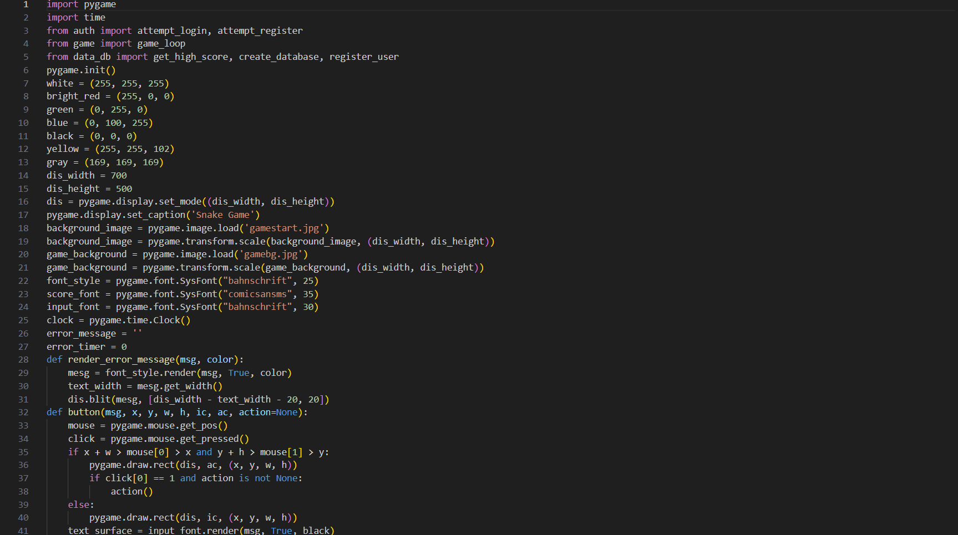
PYTHON - MYSQL CODE :
Welcome.py:

Slide 9
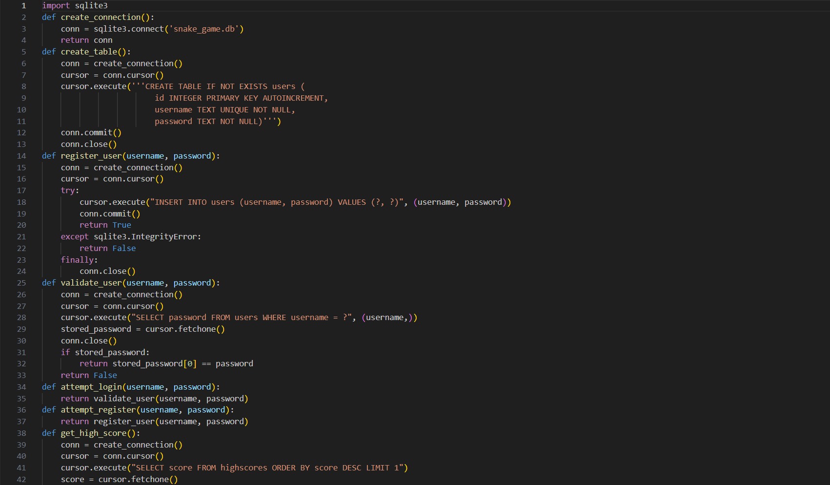
auth.py:

Slide 10
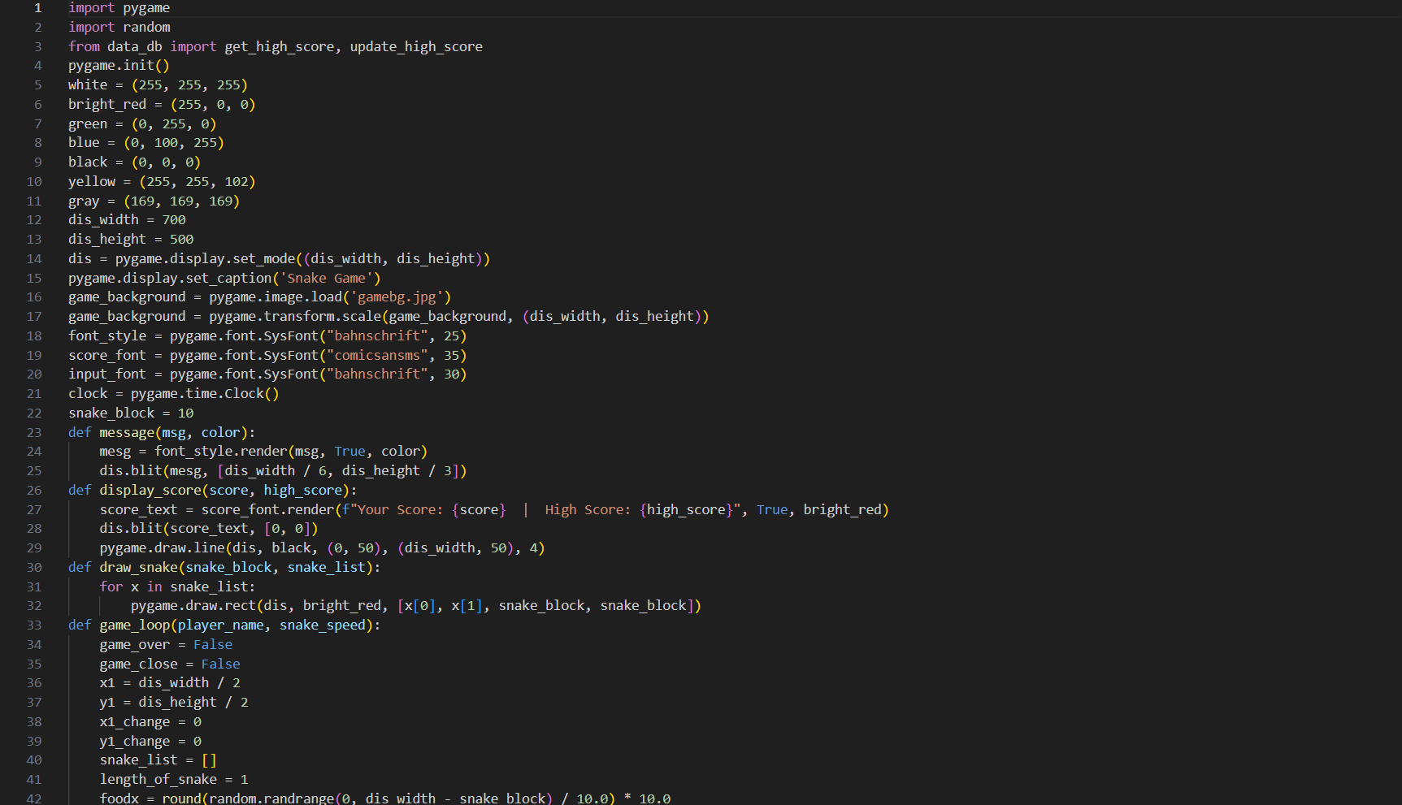
game.py:

Slide 11
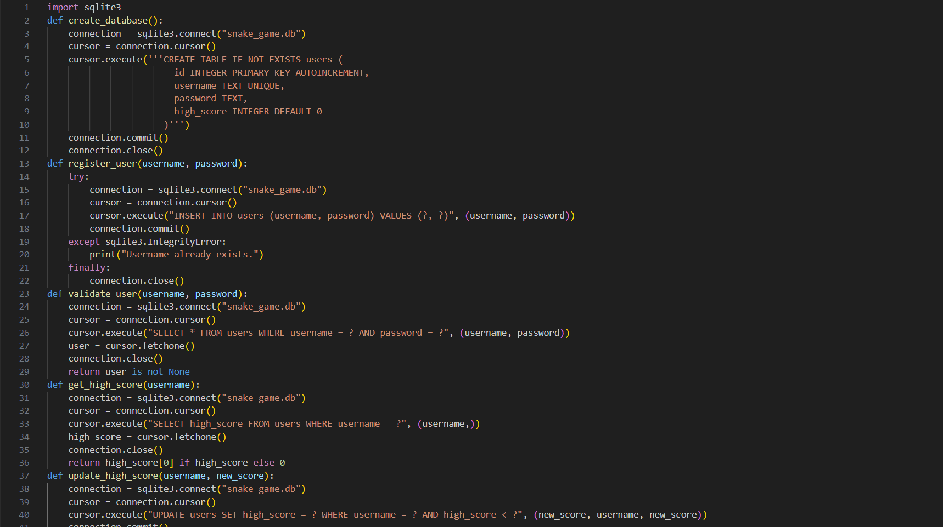
data_db.py:

Slide 12
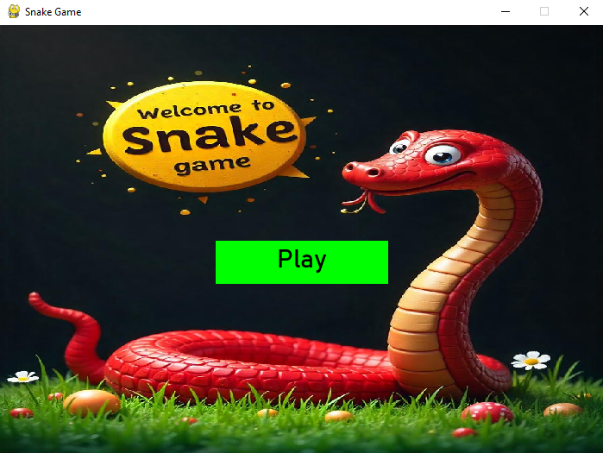
OUTPUT:

Slide 13
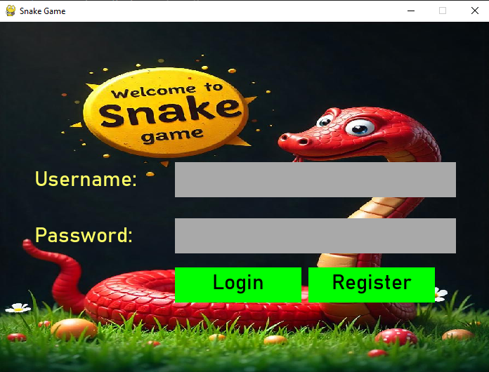

Slide 14
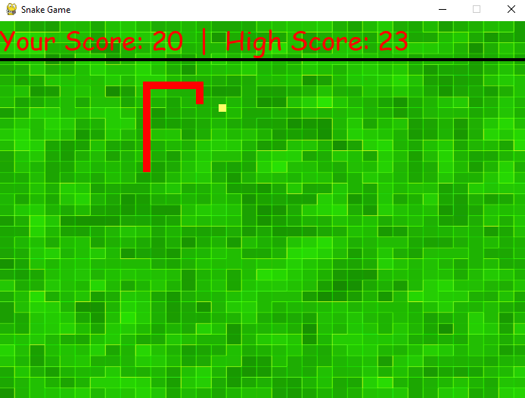

Slide 15
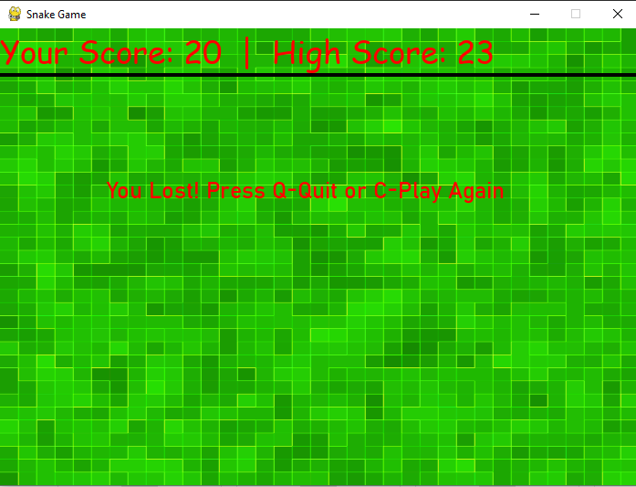

Slide 16
THANK YOU!

